Slide 1
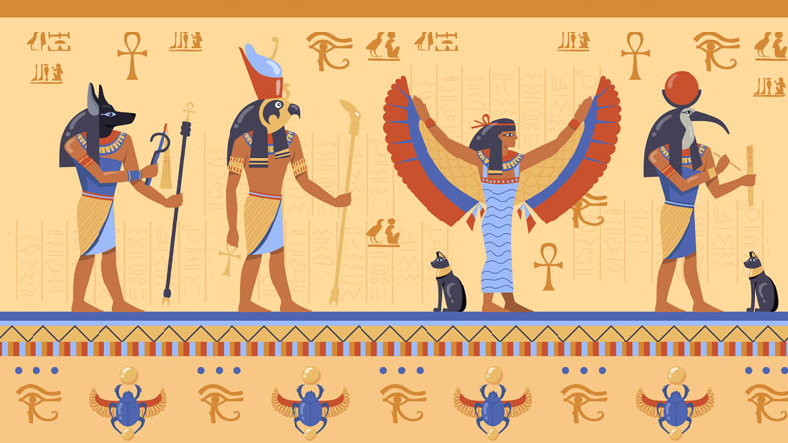
Cultural/Religious Structures
GOAL/S: Describe Ancient Egyptian Cultural/Religious Structures
Week 9, Lesson 2

Slide 2
Ancient Egypt – This week
Social/Political Structures
Economic Structures
Religious/Cultural Structures

Slide 3
Religious beliefs dominated the lives of the Ancient Egyptians. Nearly everything in their world was seen as being controlled by hundreds of deities (gods and goddesses). Their beliefs greatly influenced how they lived, what they built, and how they waged war. These beliefs also shaped their views about death and how they prepared for it.

Slide 4
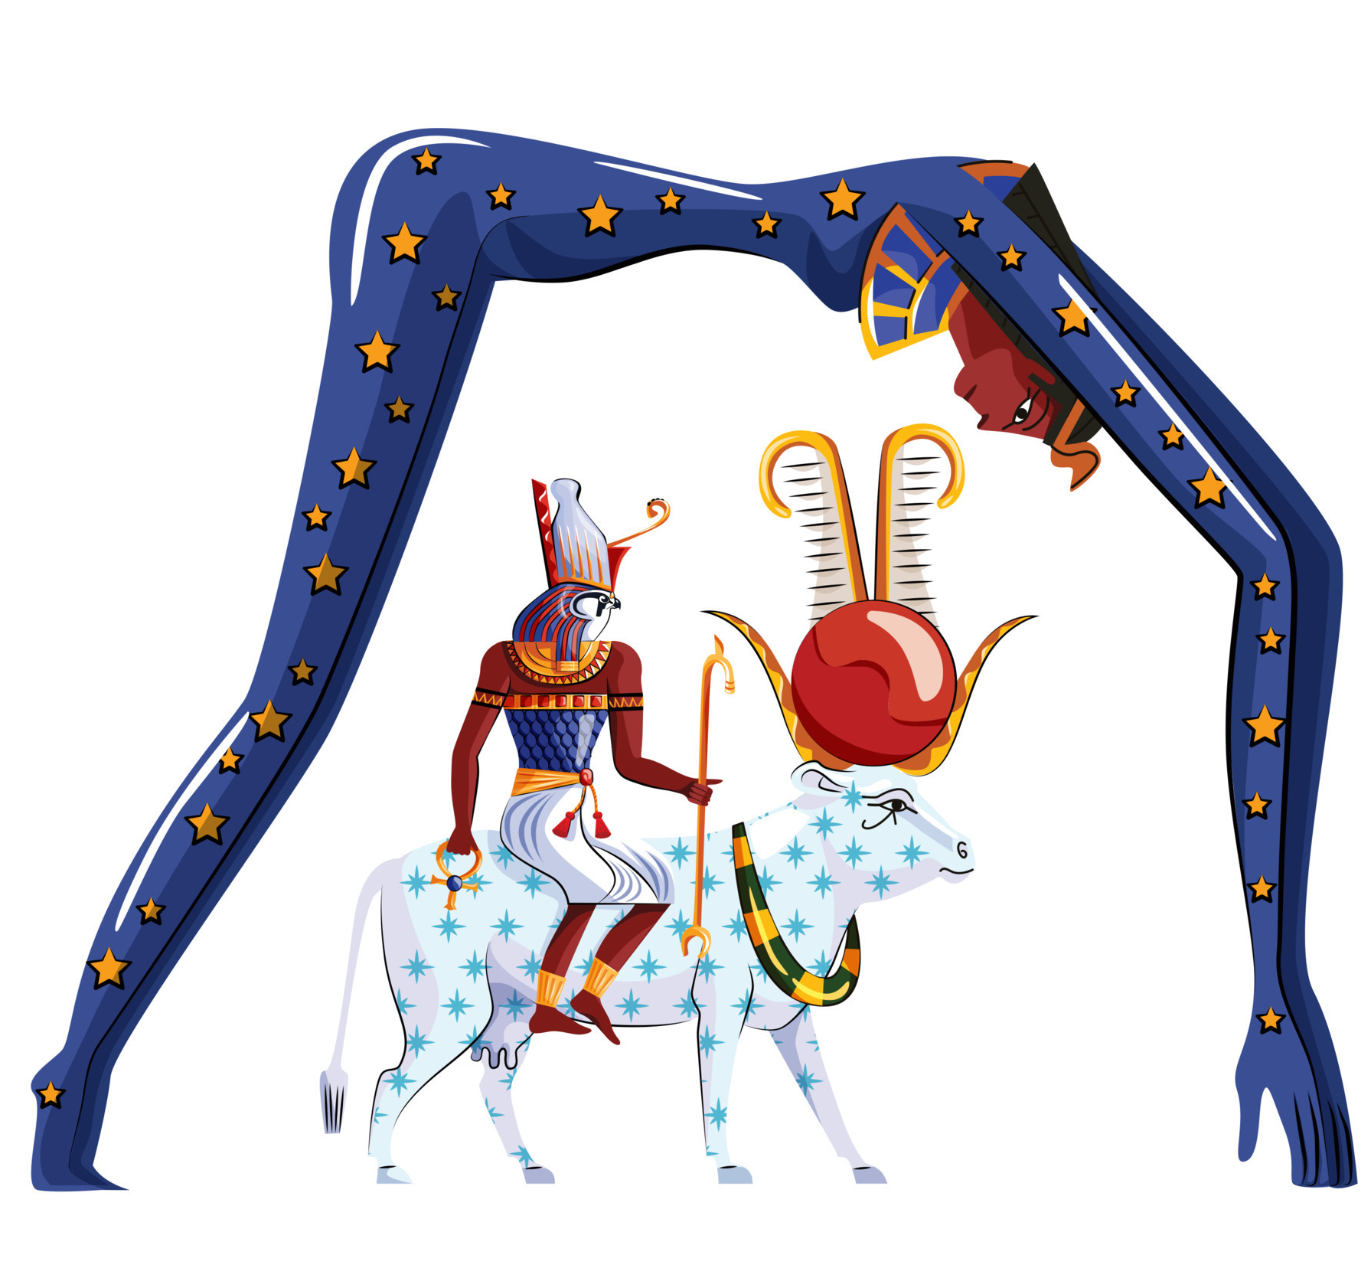
The Ancient Egyptians believed that one group of gods created the world and its living things, while another group controlled the forces of nature. There were also gods of fertility, wisdom, love, music and dance, death, health, and childbirth. The sun god Ra (or Re) was the most important god. The Egyptians believed he rode across the sky each day in a boat. Ra is often depicted with the Sun symbol on his head. He is said to travel alongside Nut, the universal mother, during the day and night. Endlessly, she swallows the Sun at night and gives birth to it the next day.

Slide 5
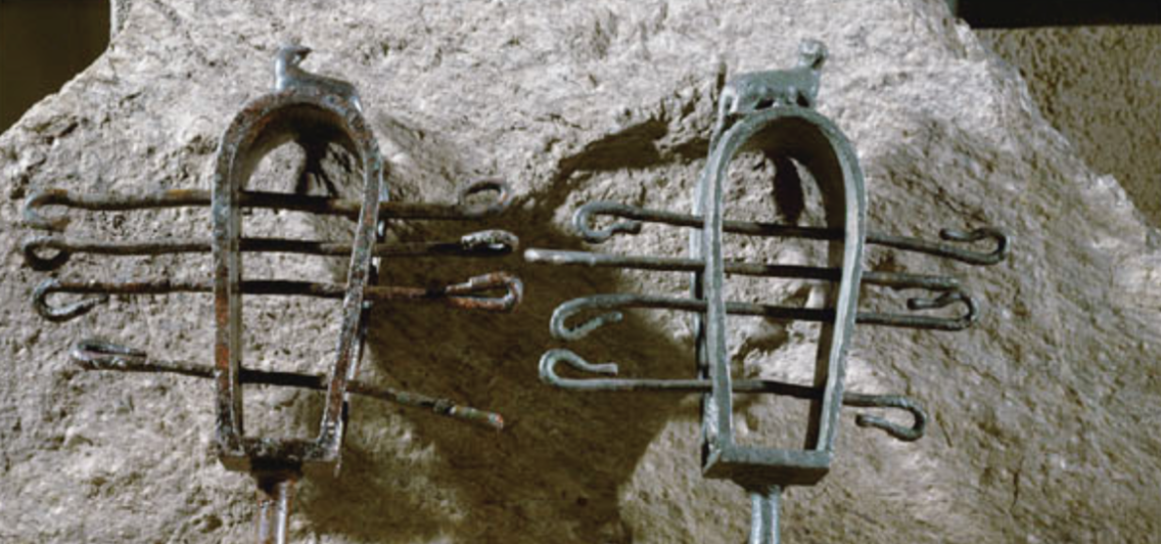
Traditions and ceremonies
build many temples were priests/priestesses served the gods that lived there
burned incense, made offerings, held festivals
ordinary people – shrines within their homes with offerings
played instruments (e.g. sistra) to keep away evil spirits
wore amulets for protection/goodwill of gods
Sistra (musical instruments) made loud, clanging sound when shaken)

Slide 6
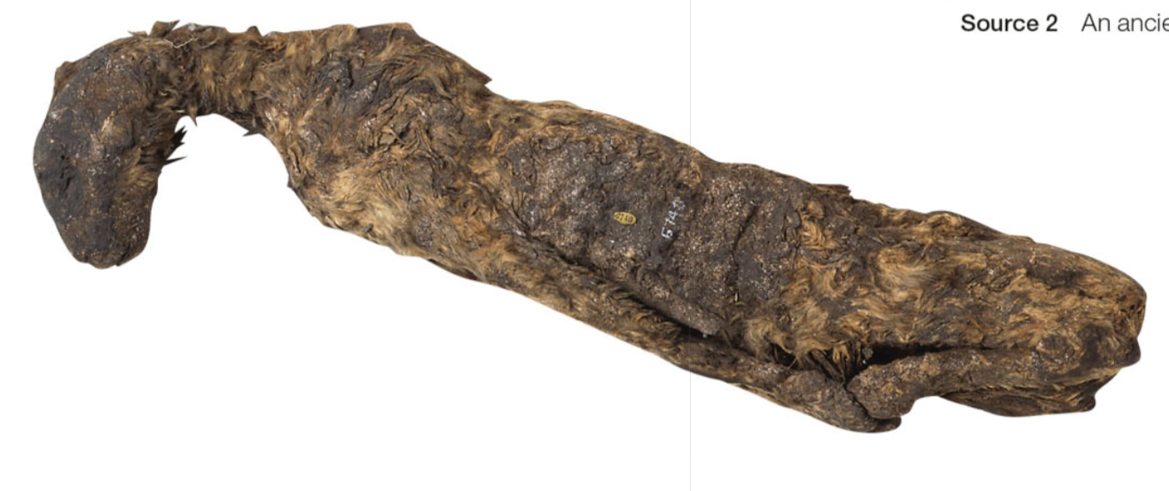
Animal Gods
Heads/bodies of animals
Sekhmet (Goddess of War) – lion
Sobek (God of Water) – Crocodile
Bastet (Protector of homes) – Cat
Egyptians valued cats highly
respect to Bastet
protected grain stores by killing vermin
harming cats could result in death
Many animals in Ancient Egypt were mummified as a sign of respect, or as offerings to the Gods. Cats, such as this one, were mummified in large numbers.

Slide 7
Death and funerary customs
Afterlife Beliefs:
The ancient Egyptians believed in an eternal afterlife where the deceased would live on if properly prepared.
The soul, or "ka," needed to be sustained through offerings and rituals.
Funerary Practices:
Funerals involved elaborate ceremonies to ensure safe passage to the afterlife.
Rituals included prayers, offerings, and the "Opening of the Mouth" ceremony, which was meant to restore the deceased’s senses in the afterlife.
Tombs and Grave Goods:
Tombs were filled with items needed for the afterlife, such as food, clothing, jewelry, and amulets.
Wealthy individuals had more elaborate tombs, often decorated with inscriptions and scenes from their life and beliefs about the afterlife.

Slide 8
In order to reach the afterlife, the Ancient Egyptians believed that the dead person would need magic spells and special prayers to support them through any dangers and further rituals on their journey. These spells and rituals were recorded in the Book of the Dead. A copy of the book was often buried with the dead person.

Slide 9
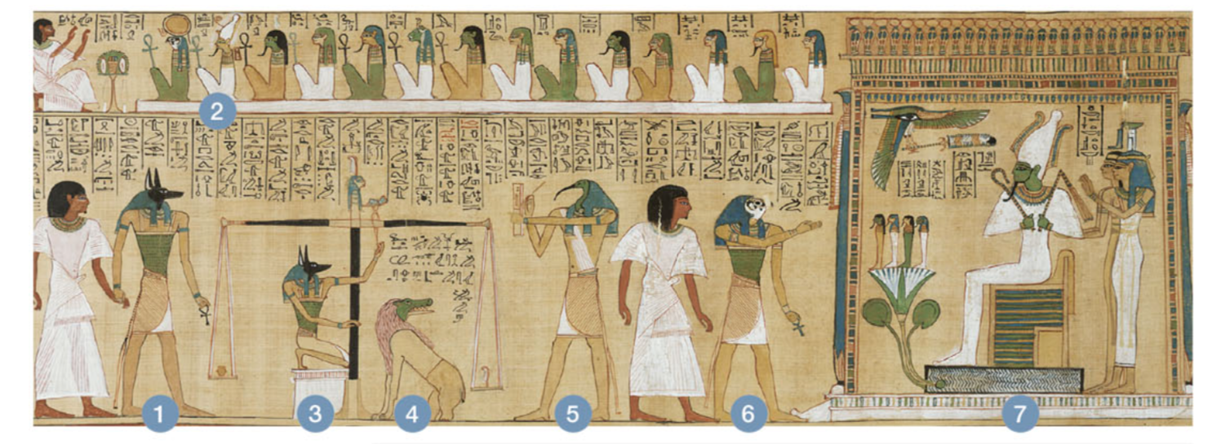
1 | 2 | 3 | 4 | 5 | 6 | 7
Anubis, god of embalming and the dead, leads the dead person to judgement. | A row of judges sit watching. | Anubis weighs the dead person's heart against a feather from the headdress of Ma'at, the goddess of truth and justice. If the heart is lighter than the feather, it means the person has led a good life and will be admitted to the afterlife. | Ammit. a female demon with the head of a crocodile. will eat the dead person's heart if it is heavier than the feather. | Thoth, god of writing and knowledge, records the result of the weigh-in. | Horus, god of the sky and ruler of the world of the living, leads the dead person (who has passed the test) to Osiris. | Osiris, god of the dead and the underworld, allows the person into the afterlife.

Slide 10
Mummification
SUMMARISE THE STEPS
1. Removal of Internal Organs: The brain was removed through the nostrils using hooks. An incision was made on the left side of the abdomen to remove internal organs, which were then dried and placed in canopic jars, each protected by a deity. The heart was usually left in place, believed to be the center of intelligence and emotion. | 2. Dehydration: The body was covered in natron, a naturally occurring salt, to dehydrate and preserve it. This process took about 40 days.
3. Wrapping: After dehydration, the body was washed and anointed with oils. It was then wrapped in linen bandages, often with protective amulets placed between layers. The wrapping process included multiple layers and could take 15 days or more. | 4. Final Preparations: A death mask, often made of cartonnage (a type of material similar to papier-mâché) or precious metals for the wealthy, was placed over the head. The mummified body was placed in a series of coffins, often elaborately decorated. The outermost coffin was usually placed in a sarcophagus, a stone container.

Slide 11
Watch the following
https://www.youtube.com/watch?v=WqJd8slanIo&ab_channel=WhatIf

Slide 12
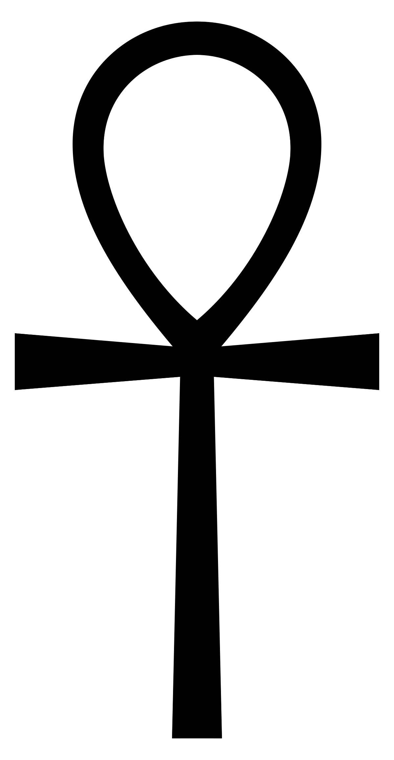
Important Symbols - Ankh
Hieroglyphic symbol used to represent the word for "life" and, by extension, as a symbol of life itself

Slide 13
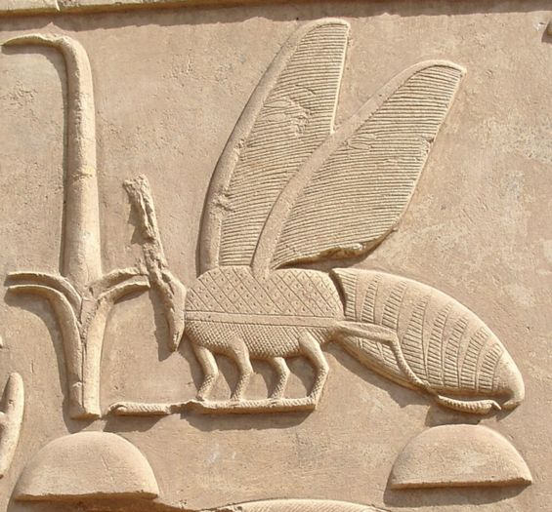
Important Symbols - Bee
Symbol of royalty in Lower Egypt.

Slide 14
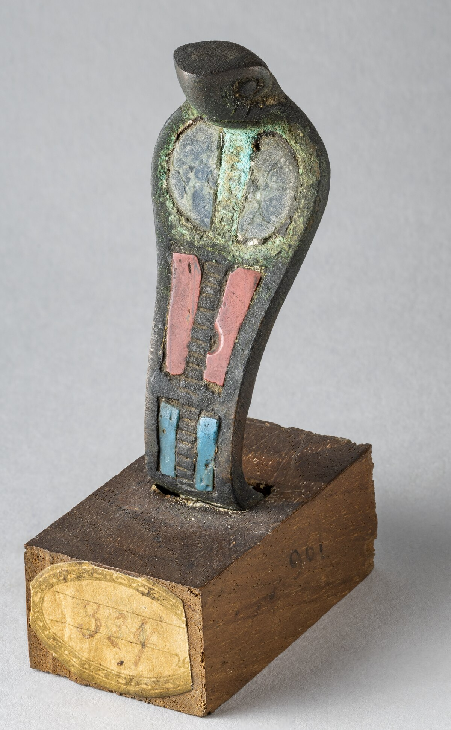
Important Symbols - Ureaus
The Cobra associated with Goddess Wadjet.
Worn on headdresses of deities/leaders

Slide 15
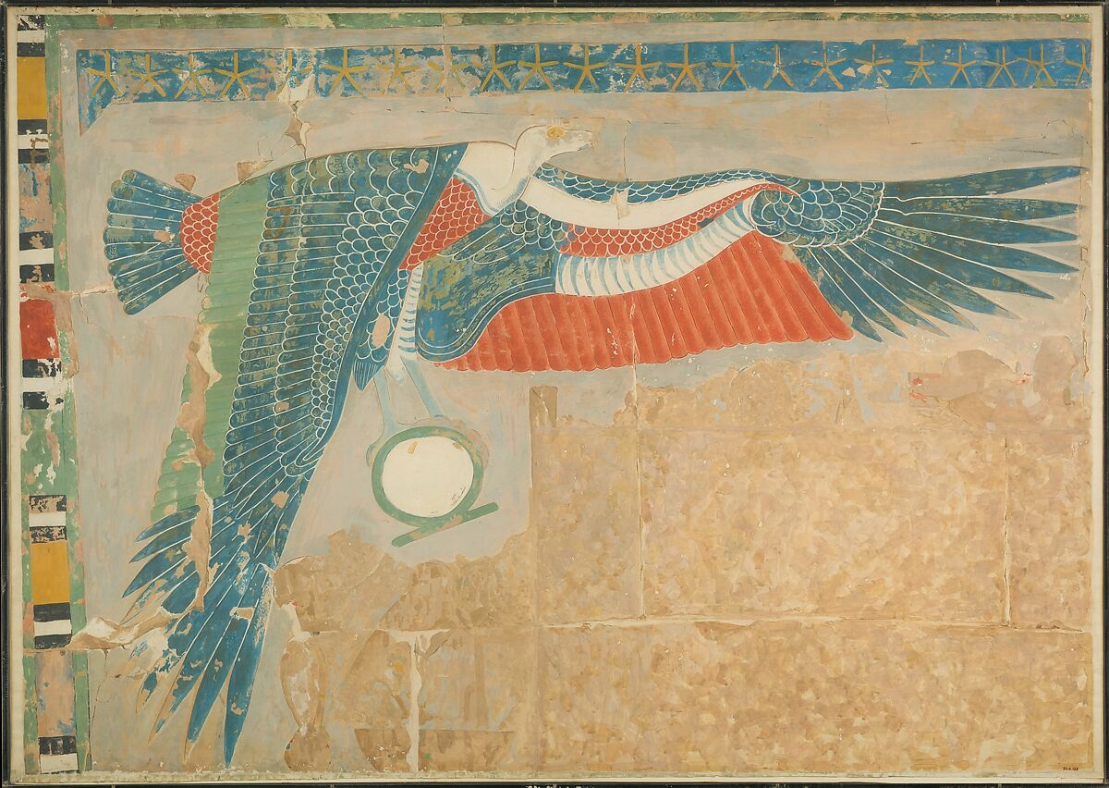
Important Symbols - Nekhbet
Nekhbet, ancient predynastic goddess (vulture)
A symbol of Upper Egypt.

Slide 16
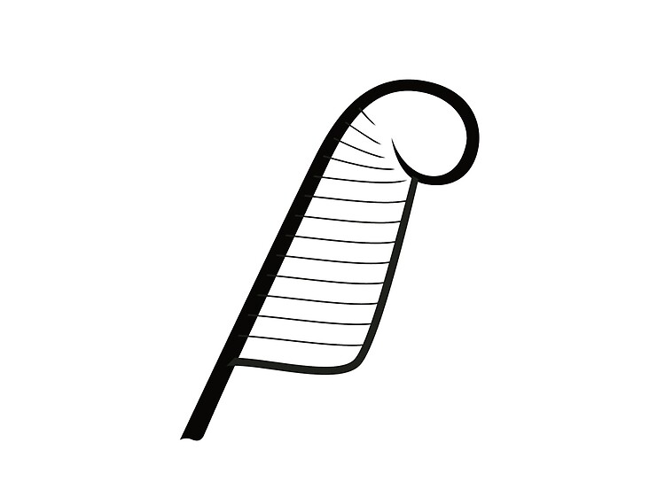
Important Symbols – Ma’at feather
Order and Balance
Represented as a feather

Slide 17
ACTIVITY – TEEL Paragraph
Write a TEEL paragraph describing the cultural and religious beliefs of the Ancient Egyptians.
TOPIC SENTENCE – Overview of belieds
EXPLANATION – Explain specific beliefs
EXAMPLES – Give specific example/s of beliefs
LINK – Summarise the paragraph

